Slide 1
Using Machine Learning to Predict the 2016 Trump Vote
John Lee
Department of Sociology
STAT 359 Final Project

Slide 2
Outline
Introduction
Research Questions
Design
Data
Methods
Data
Methods
(1) Logistic Lasso
(2) Decision Trees: Bagging, Random Forest, Boosted Trees
(3) SVC/SVM: Linear, Polynomial, Radial Kernels
Findings

Slide 3
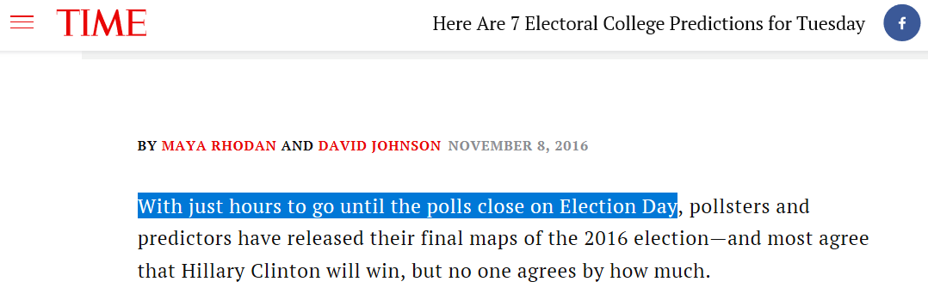
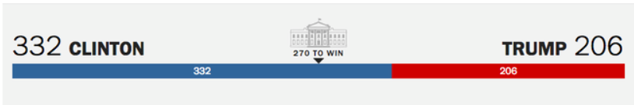
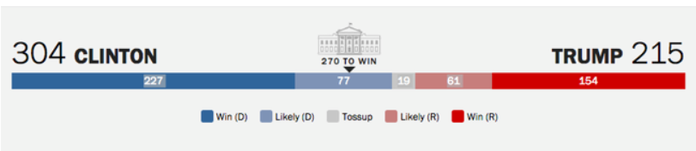
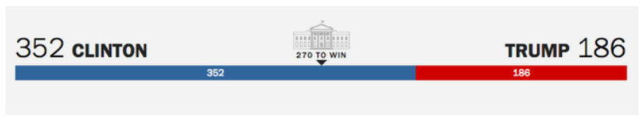

Most Analysts Predicted that Hilary Clinton would Win the 2016 U.S. Presidential Elections
Article from the day of the election
Moody’s Analytics
Sam Wang (Princeton)
LA Times
Larry Sabato (Virginia)

Slide 4
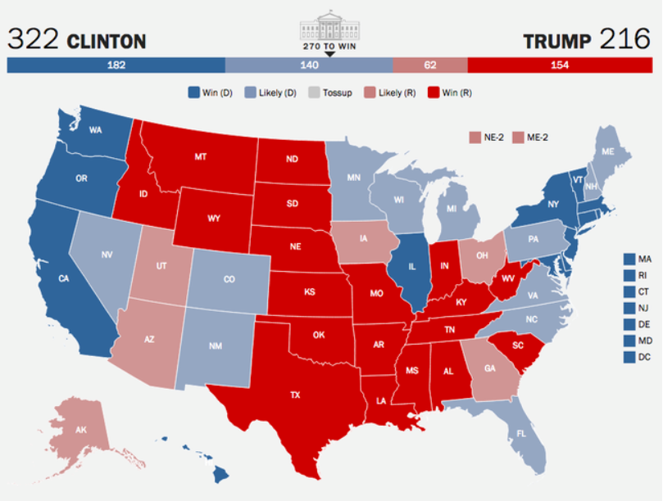
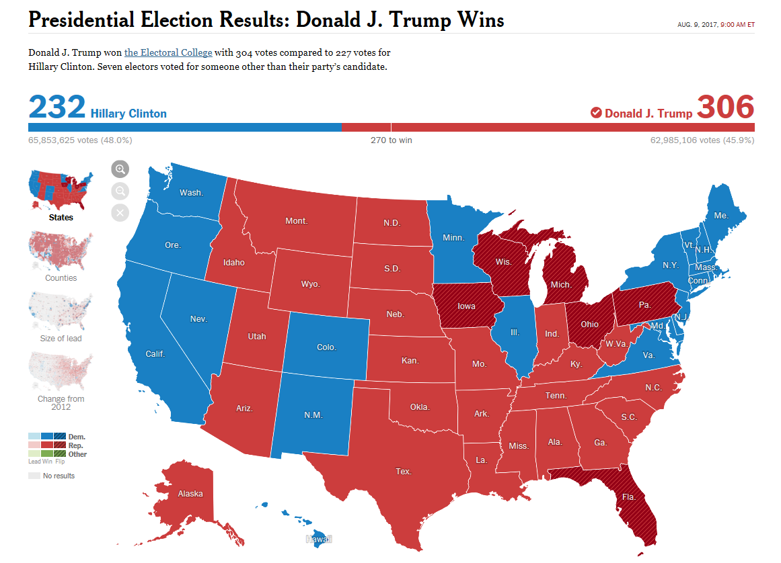
2016 U.S. Presidential Elections: Predictions v. Results
(1) Predicted Results
(2) Actual Results
Source: Larry Sabato, University of Virginia
Source: New York Times

Slide 5
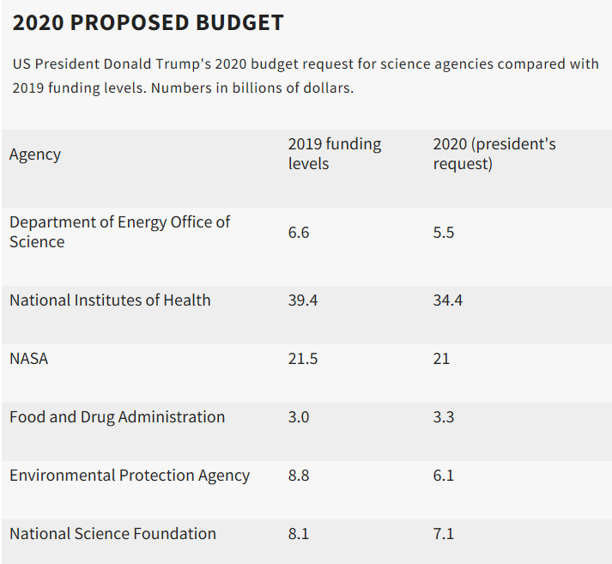
Why Does this Matter?
Does it matter who the U.S. president is?
Here’s just one illustration of why it does matter:
President Trump’s administration has proposed cutting billions of dollars in federal funding for research
Other considerations: immigration policy, visa issues
Source: https://www.nature.com/articles/d41586-019-00851-1

Slide 6
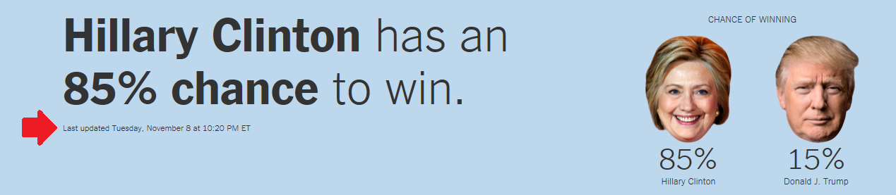
So what happened on November 8, 2016?
Why were the polls so wrong (even up to the day of the election)?
Are individual voters fickle? Is their voting behavior difficult to predict?
Or, are there other explanations?
E.g., surveys were not representative (e.g., missed voters in rural areas), people did not honestly say they would vote for Trump over the phone (social desirability bias)
Source: New York Times

Slide 7
Research Questions
(1) Which models (e.g., SVM, boosted trees) are the best at predicting the 2016 Trump vote?
Best: defined as having the lowest test error rate, or the highest prediction accuracy on the test set
(2) Which covariates are the strongest predictors of the 2016 Trump vote?
Are the important predictors consistent across the models?

Slide 8
Research Design
Data collection
Analysis: Three Stages
(1) Split the data into training and test sets
(2) Use 10-fold cross-validation to identify candidate models
(i) Logistic Lasso
(ii) Decision Trees: Bagging, Random Forest, Boosted Trees
(iii) SVM: Linear, Polynomial, Radial Kernels
(3) Assess the candidate models by comparing the test error (i.e., error rates from the held-out test set)

Slide 9
Data
American National Election Studies (ANES)
Coordinated by PIs at Michigan and Stanford
Runs a survey before and after every U.S. presidential election
Dual-mode nationally representative probability-based sampling
(1) face-to-face mode: multi-stage stratified cluster sampling
(2) internet mode: random sample from the U.S. Post Office’s list of delivery addresses (residual addresses only)
Target population: U.S. citizens who are at least 18 years old
Sample size:
Round 1: Before election
face-to-face interviewing: n=1,180
Internet: n=3,090
Total sample size: 4,270
Round 2: After election
Re-interview rate: 90% for face-to-face interviews, 84% for the Internet sample
Source: 2016 ANES User Guide/Codebook (pp. 3-6)

Slide 10
Variables
Standardized continuous predictors are bolded; the others are categorical
Dependent variable:
Voted for Donald Trump in the 2016 U.S. presidential elections
Demographic
Gender, race, age
Socioeconomic status:
Education attainment, income band
Social, cultural:
Martial status, religion
General partisanship, ideology
Democratic Party feeling thermometer, Republican Party feeling thermometer, Conservative scale
Specific policy issues
Support for Obamacare, Support for Gun Control, Opposition to the Wall, Pro-Choice

Slide 11
Analysis Plan
Final dataset:
N = 2,394 (after excluding those who did not vote, listwise deletion)
Analysis: Three Stages
(1) Split the data into training and test sets
Training (70%): N = 1,676
Test (30%): N = 718
(2) Use 10-fold cross-validation to identify candidate models (7) – i.e., the “best” model from each model type (with optimized tuning parameters)
(i) Logistic Lasso
(ii) Decision Trees: Bagging, Random Forest, Boosted Trees
(iii) SVM: Linear, Polynomial, Radial Kernels
(3) Assess the 7 candidate models by comparing their test errors (i.e., error rates from the held-out test set)

Slide 12


(1) Logistic Lasso Regression
The objective function for the logistic lasso regression uses the negative binomial log-likelihood:
Basically, it is seeking the vector of coefficients that solves this objective function; the main thing to remember is that it is subject to the constraint (or budget for the coefficients) on the right.
The algorithm “use cyclical coordinate descent, which successively optimizes the objective function over each parameter with others fixed” – and repeats the cycle until convergence
Source: https://web.stanford.edu/~hastie/glmnet/glmnet_alpha.html
TP
Constraint (Budget)
alpha = 1 for lasso

Slide 13
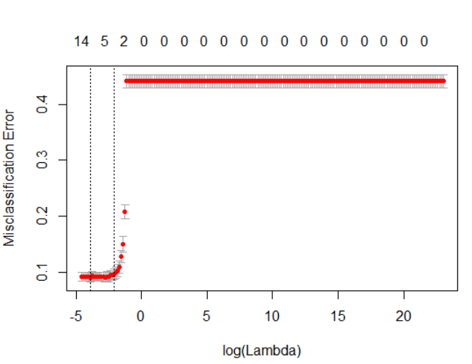
10-Fold CV Process for the Logistic Lasso
Ideal value of lambda: 0.020022 (or equivalently, the ideal ln(lambda) was ~ -3.91
Interpretation: relatively small penalty is ideal, which means that many of the covariates are useful predictors of the outcome
Estimated CV error rate: < 10%

Slide 14
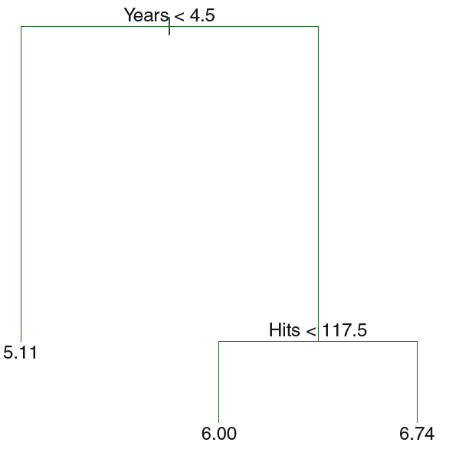
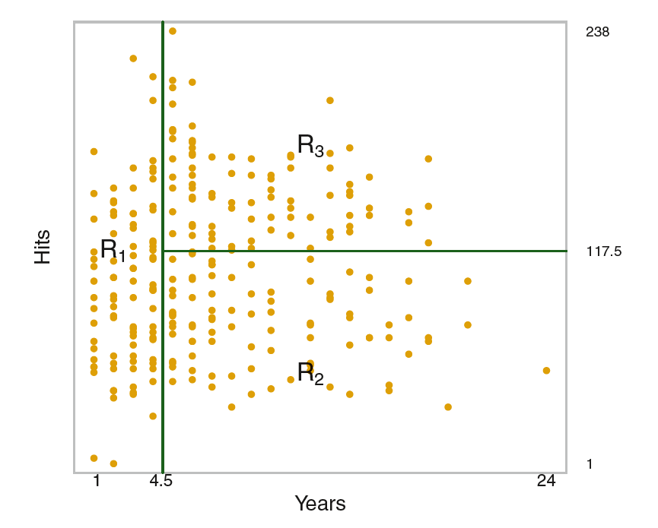
(2) Tree-Based Methods
A brief review of how they work:
Each tree divides the observations into regions of the predictor space. The splitting is hierarchical/sequential, and operates as follows:
Internal nodes refer to the place where the splits are made. The splits (i.e., predictor used, values of the predictor) are chosen in order to maximize the purity/homogeneity of the child nodes (w.r.t. to the DV classes) -- Gini impurity or cross-entropy
The first split has the most explanatory power, the second split has the second most explanatory power, and so on
The splitting ends after a stopping point is reached
The trees are then “combined”
The illustrations are from the ISLR textbook
The three tree-based methods I’ll be testing:
(1) Bagged trees, (2) Random forest, (3) Boosted trees

Slide 15
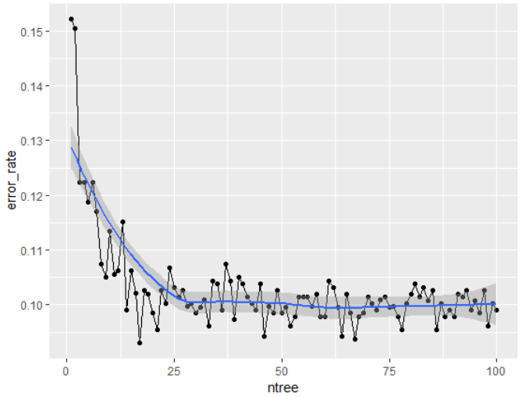
(2a) 10-Fold CV for Bagged Trees
Bagging: This entails creating B bootstrap samples, fitting a classification tree using each sample, and then averaging across the trees
Main tuning parameter: B (ntree), number of bootstrapped trees
CV Results: diminishing returns after B (ntree) ~ 40 or so. Just to be safe, I selected B = 50 for my candidate model
Estimated CV error rate: ~10%

Slide 16
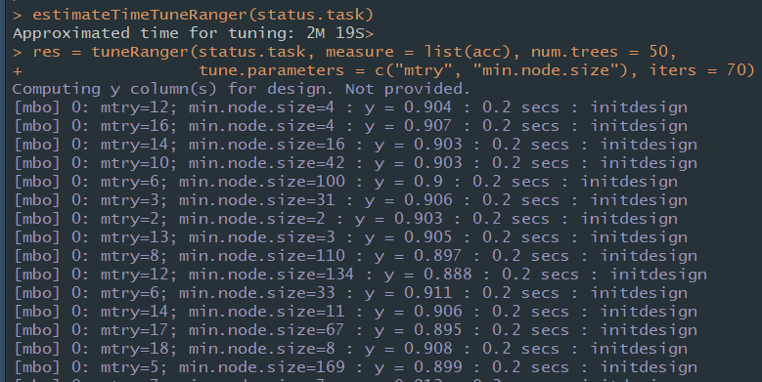
(2b) 10-Fold CV for Random Forest
RF: Same as bagging, but now we’re considering only a random subset of the p predictors at each split
Main tuning parameters: number of predictors to try at each split (mtry), minimum node size
CV Results: best mtry: 10, best min node size: 14;
Estimated CV error rate: ~10%

Slide 17
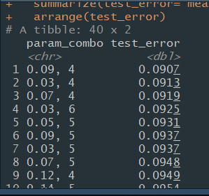
(2c) 10-Fold CV for Boosted Trees
BT: The trees are grown sequentially; each tree is fit to the residuals from the previous tree
Main tuning parameters: learning rate (eta), max tree depth
CV Results: best eta: .09, best max tree depth: 4;
Estimated CV error rate: ~9%

Slide 18
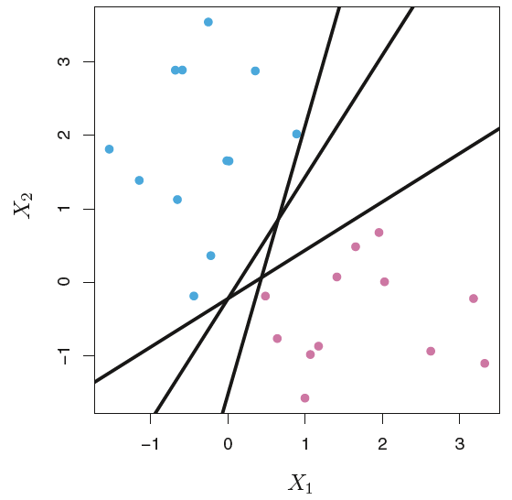
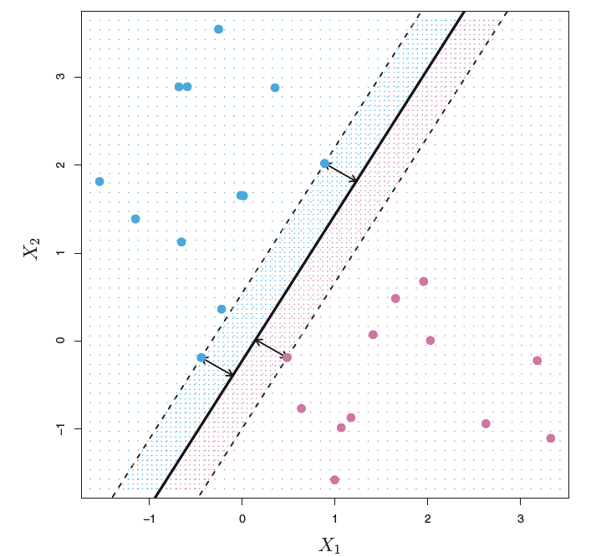
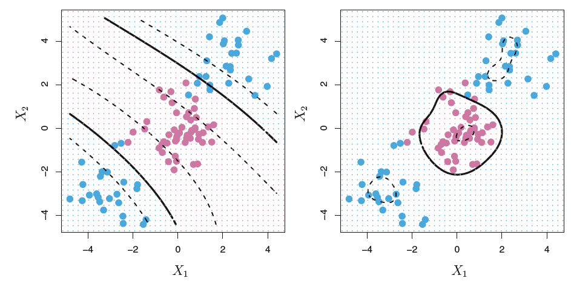
(3) Support Vector Machines
Multiple Hyperplanes
A brief review: SVMs seek to group observations into the correct class by using hyperplanes as decision boundaries
Hyperplanes are a p-1 dimensional flat subspace in a p-dimensional space: e.g., if p = 2 (there are 2 predictors), then the hyperplane is simply a line; if p = 3, then the hyperplane is a 2d plane
Problem #1: However, there are often many hyperplanes (or set of coefficients) that can correctly classify the observations, since the hyperplane can be slightly adjusted in any direction and probably still produce the same classifications.
Solution: maximize the margins, or the distance between the data points and the hyperplane (maximum margin classifier or MMC)
Problem #2: sometimes, there is no perfectly separating hyperplane; and even if there is, it is highly sensitive to individual observations – which can lead to overfitting.
Solution: allow some observations to fall on the wrong side of the margin and/or hyperplane → reduces variance
How many observations should be allowed to fall on the “wrong side” (budget) – bias-variance trade-off that should be optimized using CV
The three methods I’ll be testing: (1) Linear SVC; (2) Polynomial SVM; (3) Radial SVM
Image source: ISLR
Decision Boundaries:
Polynomial v. Radial Kernels

Slide 19
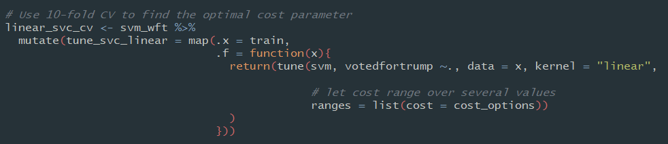
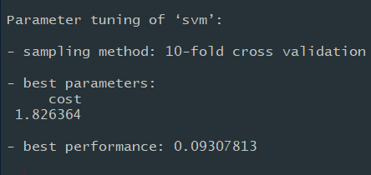
(3a) 10-Fold CV for SVC (Linear)
Main tuning parameter: cost
CV Results: best cost: 1.826364
Estimated CV error rate: ~9.3%

Slide 20
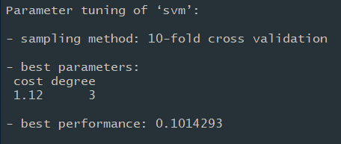
(3b) 10-Fold CV for SVM (Polynomial)
Main tuning parameter: cost and degree
CV Results: best cost: 1.12, best degree: 3
Estimated CV error rate: ~10.1%

Slide 21
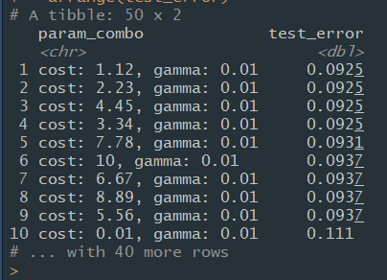
(3c) 10-Fold CV for SVM (Radial)
Main tuning parameters: cost and gamma
CV Results: best cost: 1.12, best gamma: 0.01
Estimated CV error rate: ~9.3%

Slide 22
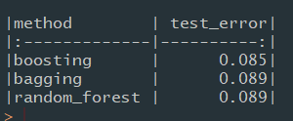

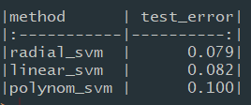
Results #1: Comparing the Candidate Models
Next, we can compare the performance of the 7 candidate models by using the held-out test set (30% of the data)
Findings: after tuning, most of the candidate models achieve test prediction accuracy of ~91%+
Tree-based Methods
Logistic Lasso
SVC/SVM Methods

Slide 23
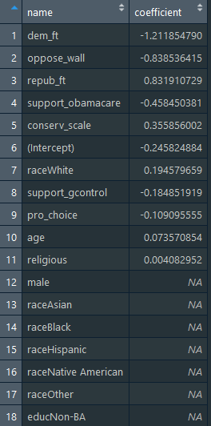
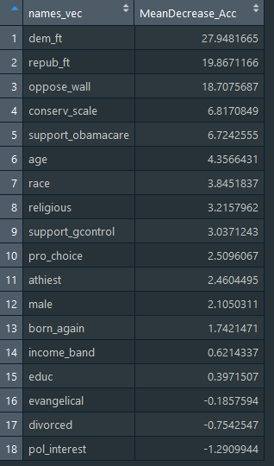
Results #2: Comparing the Predictors
Logistic Lasso
Random Forest
Findings: Key predictors are consistent
Partisanship, ideology, and policy preferences were the main drivers of the Trump vote.
Top 3 predictors: Democratic Party Feeling Thermometer, Republican Party Feeling Thermometer, Opposition to Trump’s Proposed Wall
Demographic, socioeconomic, and cultural/religious forces mattered less – even religion
This may suggest that these other factors operate indirectly
Notes:
(1) Continuous predictors were standardized, so the (lasso) coefficients are comparable
(2) Mean decrease in accuracy: provides a measure of how much the accuracy decreases when a variable is omitted – thus, the absolute value is an indicator of variable importance

Slide 24
Implications
At least at the individual, micro-level, there is very little “randomness” in the Trump vote.
In fact, given a set of key predictors (e.g., 7-8) – we can predict the likelihood of someone voting for Trump with about 90% accuracy
The survey results were thus “wrong” for other reasons (e.g., I suspect it was largely due to social desirability bias – which deflated estimates of Trump support, especially in swing states)
Can we use these individual-level models to predict the outcome of the 2020 U.S. presidential elections?
In this case, the DV would be whether a state is likely to vote for Trump (which determines who gets the state’s electoral college votes)
Yes, but we would need to add weights for the average state-level characteristics (e.g., average ideology, party support) and the likelihood of people turning out
Citation: (per my conversation with Prof. Jiang yesterday, May 27, 2019)

Slide 25
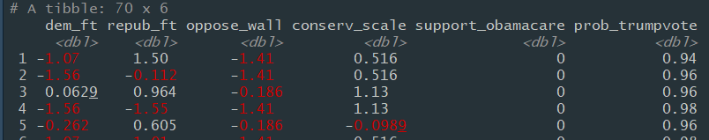
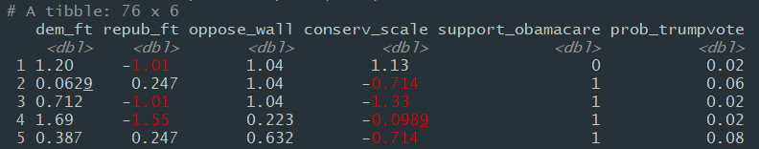
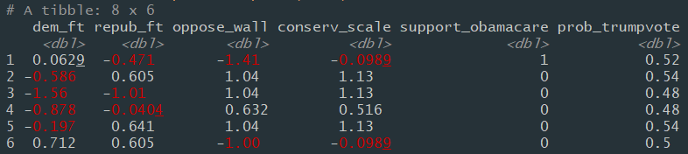
If Time: Examples of Predicted Probabilities using RF
Note: the first four predictors are standardized continuous variables; support for Obamacare is a binary predictor
Very likely to vote
for Trump (94-98%)
Very unlikely to vote
for Trump (2-8%)
“Swing voters” (46-54%)

Slide 26
Thank you!
Questions, comments?

Slide 27
References
Election forecast:
https://projects.fivethirtyeight.com/2016-election-forecast/?ex_cid=2016-forecast-analysis
https://www.nytimes.com/interactive/2016/upshot/presidential-polls-forecast.html
http://time.com/4561625/electoral-college-predictions/
Election results:
https://www.nytimes.com/elections/2016/results/president
Consequences of the election:
https://www.nature.com/articles/d41586-019-00851-1

